Slide 1
Speed Scratch Cooking
Sweetwater Union High School District
Nutrition Services
Eric Span

Slide 2
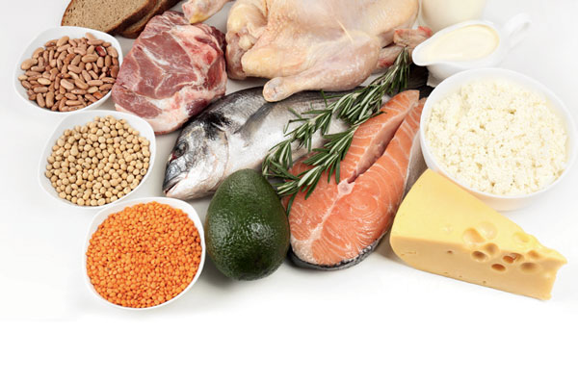
Alternative Proteins/ Sourcing
Chicken
Small batch, raw, and antibiotic free
Ex) Kung Pao Chicken
Ex) Chicken Parm
Pork
USDA/ J.T.M. Food Group/ Jones
Ex) Chorizo Breakfast Sandwich
Ex) Pulled Pork Sandwich
Ex) BBQ Rib Plate
Beef
Grass-fed angus beef, raw, cut in house
Ex) Mongolian Beef Bowl
Ex) Carne Asada Burrito
Fish
Locally sourced, humane fishing practices, Catalina Offshore Products
Tuna
Shrimp
Angelito
Ex) Ceviche
How Can You Source?
Request For Proposal (RFP)
Opportunity Bid Buy
Look For Local!
Ex) Simco, Inc.
Ex) Global Food
Ex) Catalina Offshore Products (San Diego)
Think Outside the Box
Able to use other sources than just your distributor
Put in the work for quality

Slide 3
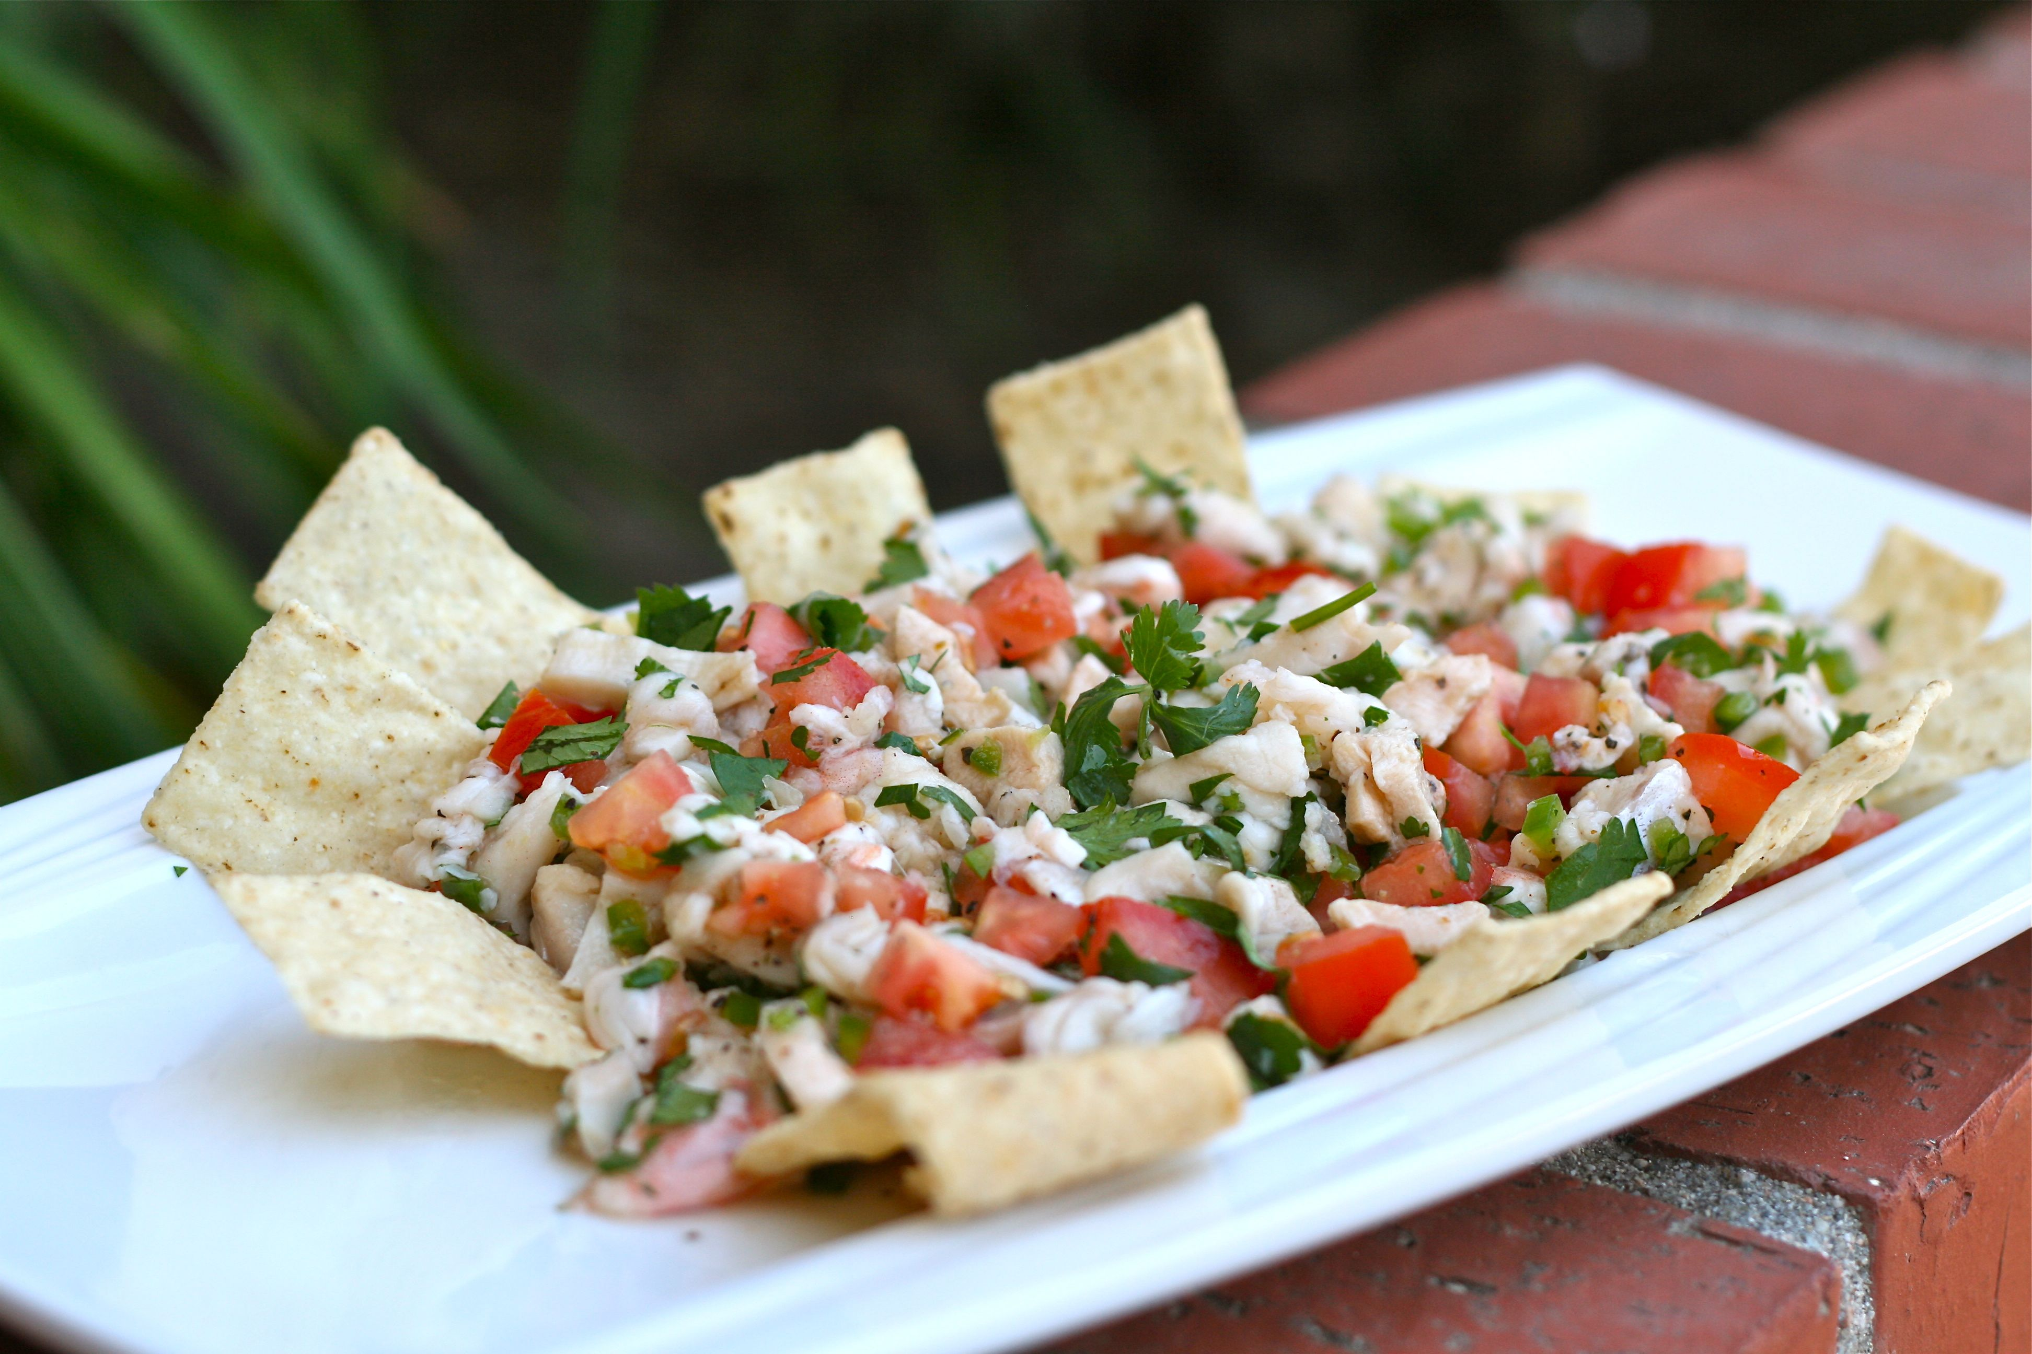
Agua Dulce Ceviche
Note: Defrost fish 3 days prior to service under refrigeration. You will prepare the fish the day before service.
Cut fish (Angelito) into similar sized pieces (about 5" long pieces) so fish cooks evenly. Line a baking sheet and place the fish on the sheet. Season each pound of fish with 1/2 tsp salt, 1/2 tsp of pepper, 1/2 tsp garlic and 2 oz, by volume, of lime juice.
Bake fish for about 15 minutes until it reaches 145 degrees F.
Cooked fish should be cooled from 135 degrees F to 70 degrees F within 2 hours and from 70 degrees F to 41 degrees F or lower in an additional 4 hours.
Cool fish to at least 70 degrees F before refrigerating. Once cooled, label with date and time and refrigerate.
The following day, place fish in a bowl shred to big chunks and add the pico de gallo, rest of the pepper & salt, lime & orange juice, cucumber, celery and tapatio.
Serve 8 ounces, by weight, of ceviche in a clear plastic container.
Serve with 2 oz., by weight, of tortilla chips.
Contribution Information: 2 oz M/MA, 2 oz grains

Slide 4
Questions?
Thank you!

